Slide 1
World Wide Sports
By Eric Maslyanchuk, Jake Gentry, Jorge Ortiz, Isaac Billow

Slide 2
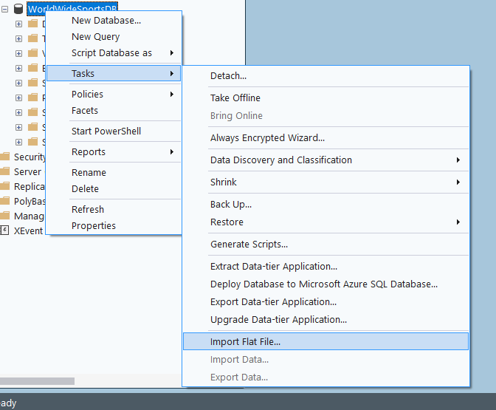
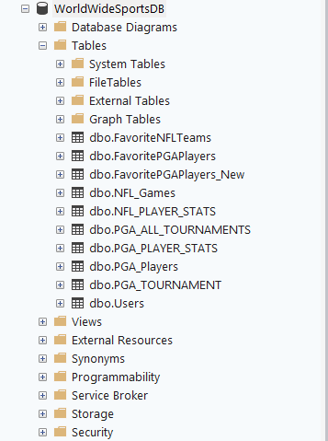
Sports Data Collection and Integration
Collected PGA and NFL datasets from outside sources.
Raw CSV data was cleaned and prepared to be imported into a SQL Server table structure.
Loaded data into SSMS by import flat file.

Slide 3
User Authentication
Create a completely functional user authentication systems with SQL Servers, TableAdapters, and Window Forms.
Login form that uses a query called CheckLogin to verify login credentials.
Form called Create Account that lets users create new accounts.
CheckUsername is a count query that prevents duplicate usernames.
CreateUser is a secure database insert action that uses an insert query
Strong password standards are used, data integrity is guaranteed, and duplicate users are prevented.

Slide 4
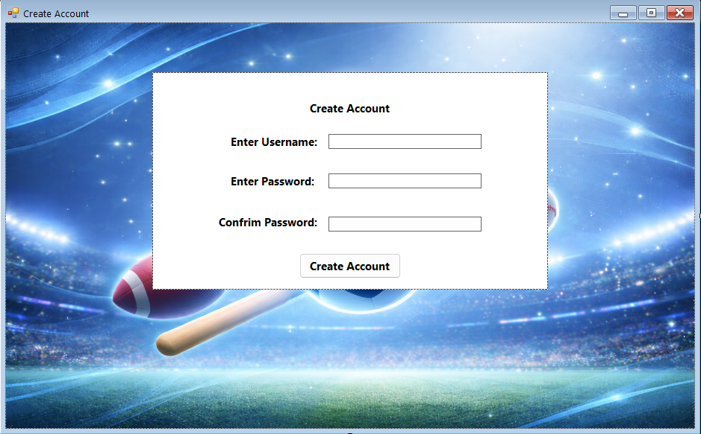
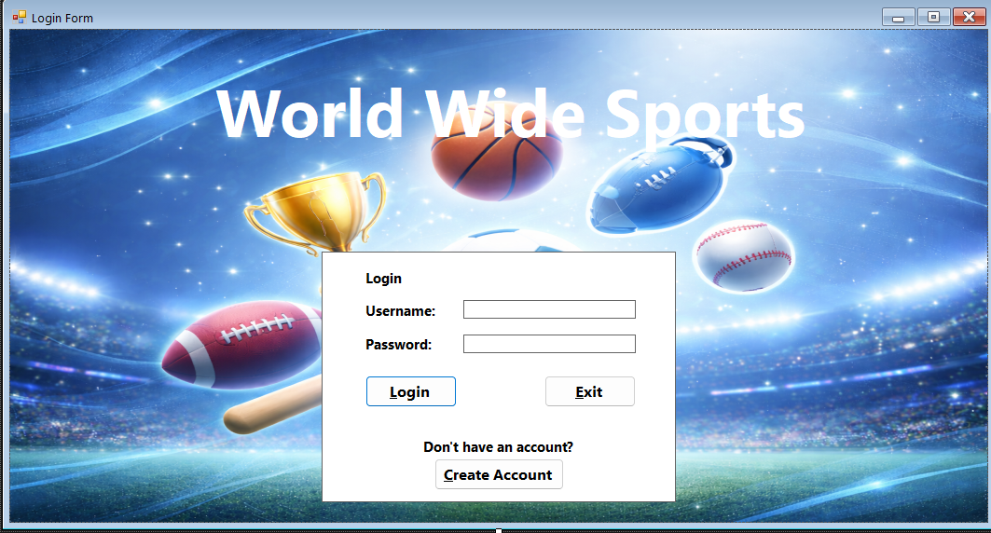

Slide 5
Seamless Main Page & User Preferences
Main Page is connected to every other form, and saves the users favorite NFL team and PGA Player
For every other form in this application, it is run through the main page acting as a home page for users
First the user must have a successful login to set their account using the SetAccount method storing the userId and username in a local variable to use the main page
Saving the users NFL team and PGA player
On form load, the NFL and PGA data is pulled from the database into a DataSet using TableAdapters, then the NFL teams and PGA Players are loaded both being bound to their combo boxes.
The current user will save their favorite team and player which will be store in the favorite team and players table storing the userId and their choice
When saved the application will check the userId in the FavoriteNFLTeams or FavoritePGAPlayers tables and see if an insert query needs to insert for a new user or update the current user’s preference

Slide 6
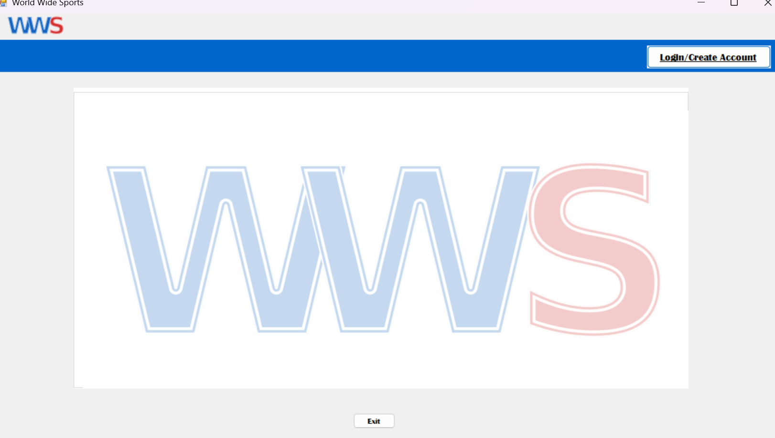
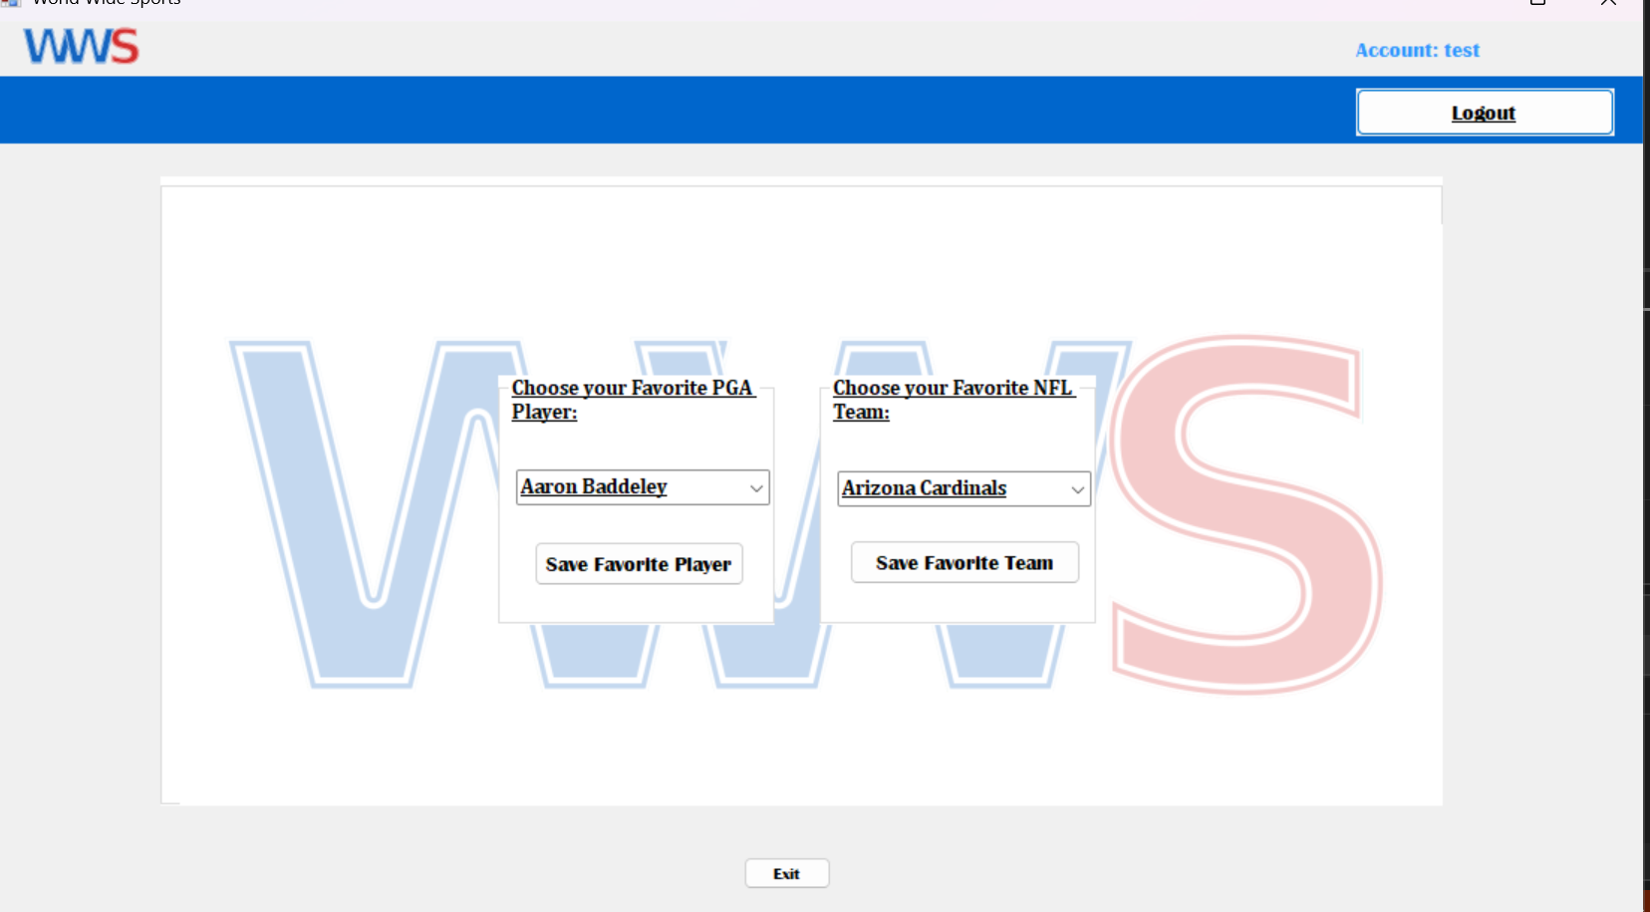
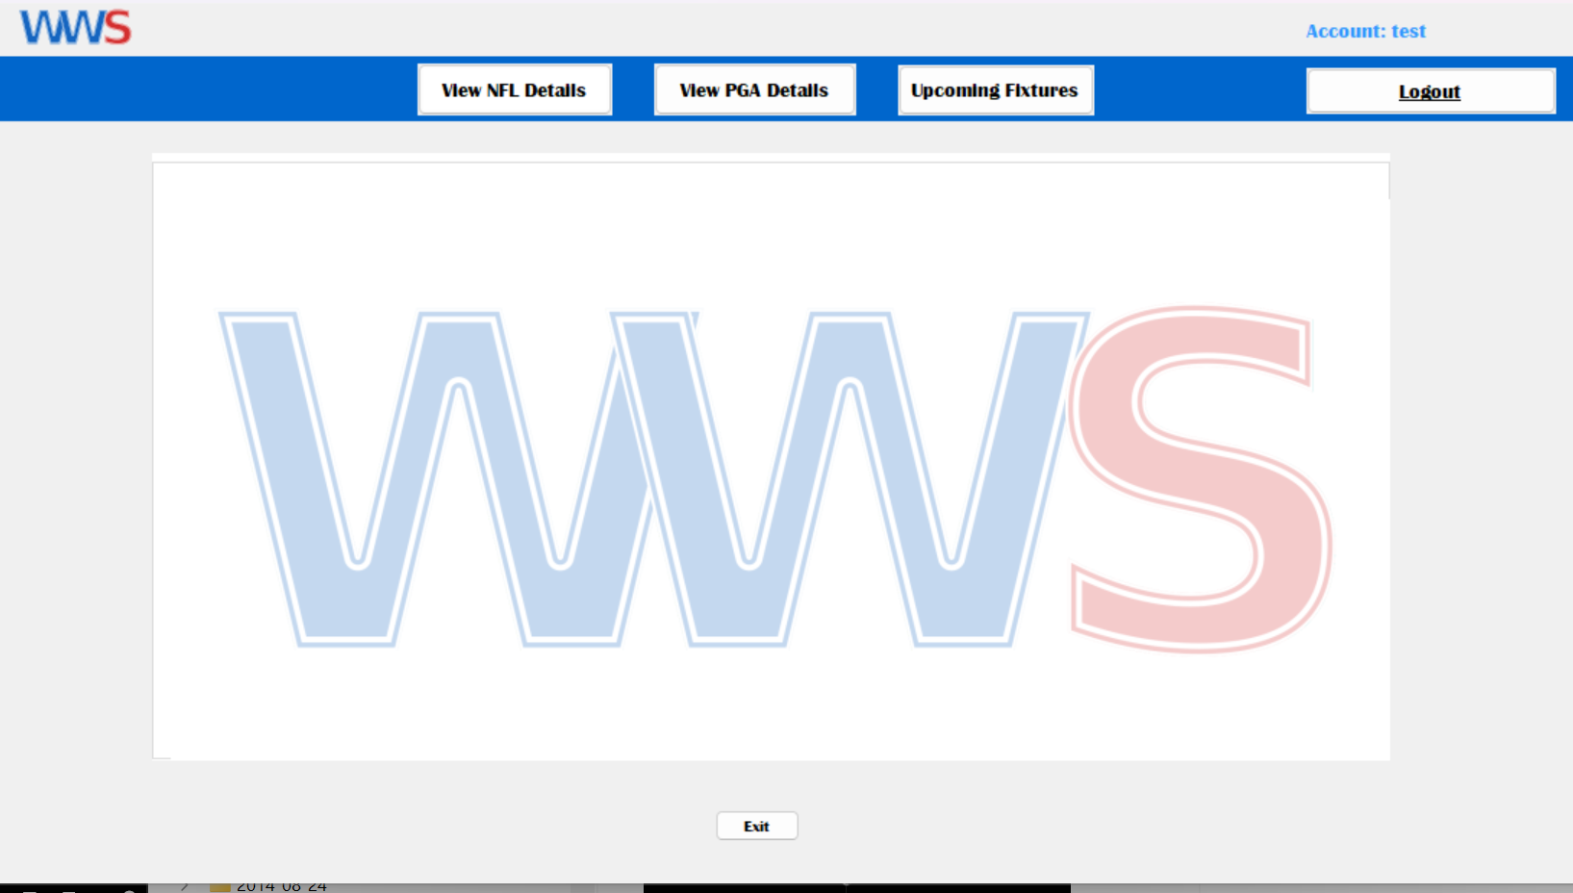

Slide 7
Upcoming Fixtures
The upcoming fixtures for NFL Games and PGA Tournaments
Used the NFLGames class and the PGAPlayerStats class to hold the data pulled from the database using TableAdapters
Used LINQ to filter the NFL_Games table for only Week 1 of the 2025 season, and mapped each row to NFLGames object
Used LINQ to filter the PGA_ALL_TOURNAMENTS table for only 2025 tournaments, and making sure duplicates were removed

Slide 8
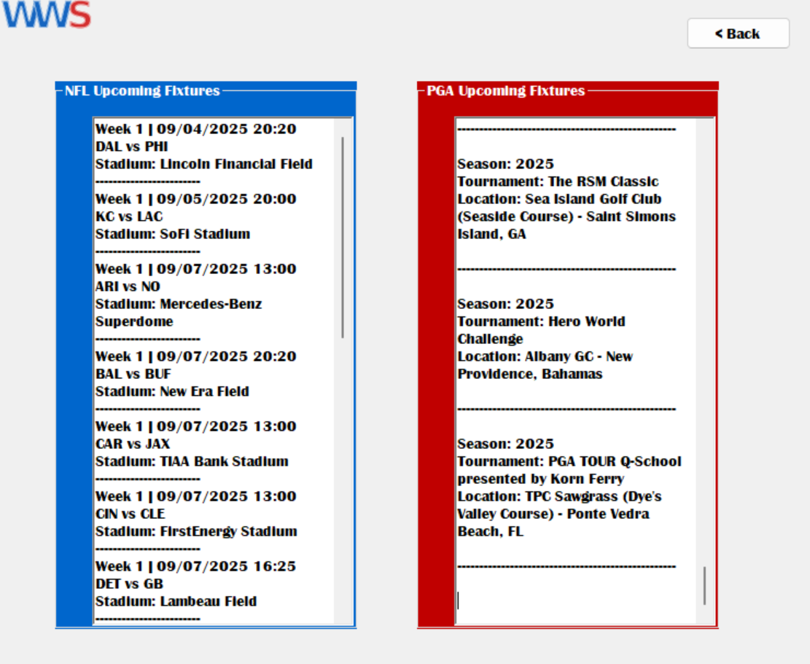

Slide 9
PGA & NFL Detailed View
Made NFL & PGA Player and Games Classes to contain data from the database
Filled Combo box from list of teams and abbreviations from the main form
Filled PGA combo box using player names in the PGA tables
Used LINQ to get every game that the selected team was the home team & compared the team selected to players from players table
Used LINQ to get any team that was favorited using the users sign in ID

Slide 10
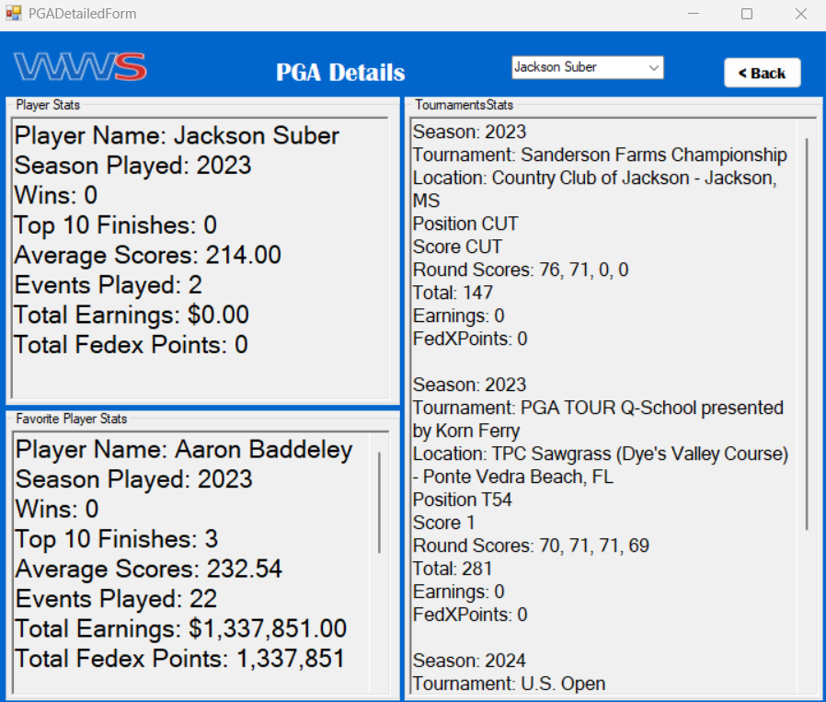

Slide 11
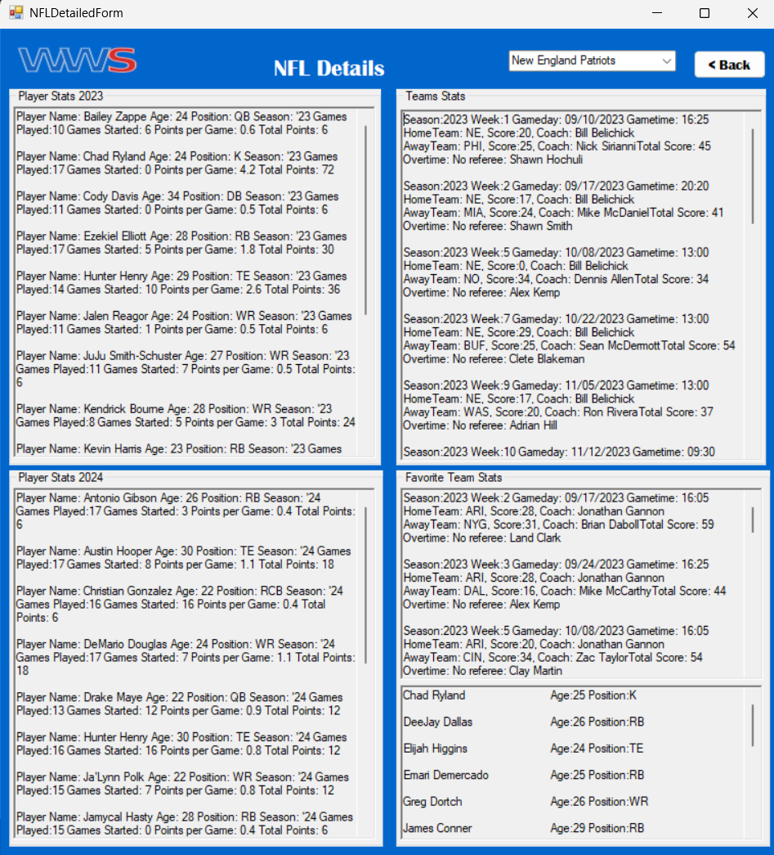
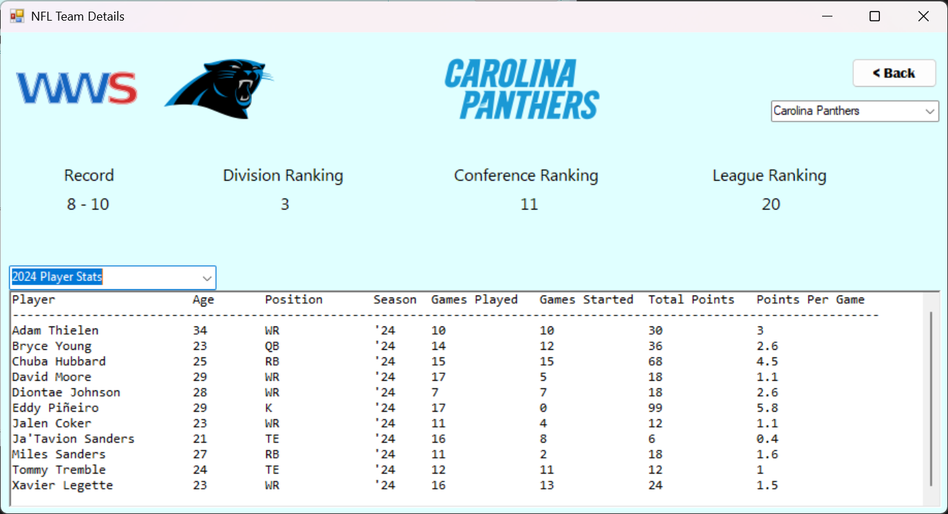
Before & After

